Slide 1
Learning Outcomes
LO 4.1 Identify the versions of DOS, its strengths, weaknesses, and why it is still in use
LO 4.2 Install DOS on a physical or virtual machine, and create a live CD
LO 4.3 Work with the DOS command prompt for file management and other tasks
LO 4.4 Understand the DOS boot-up process
LO 4.5 Troubleshoot common DOS problems

Slide 2
DOS Basics
What is DOS?
  Disk Operating System
    Single-user/single-tasking OS
    Name derived from support of disks
    Command-line interface called the DOS prompt
    No integrated GUI

Slide 3
DOS Basics
Versions of DOS
  MS-DOS
    PC DOS licensed to IBM beginning in 1981
    MS-DOS OEM licensed to manufacturers
    Digital Research (of CP/M fame) introduced
    DR-DOS in 1987
    DR-DOS 8.0 introduced in 2004 by DeviceLogics
    FreeDOS distributed without charge under
    GNU GPL license

Slide 4
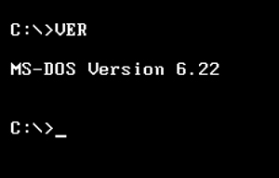
DOS Basics
Versions of DOS
  PC DOS
    IBM offered new versions through PC DOS 2000
    Compatible with any Microsoft/Intel PC
    IBM ended product support January 31, 2001
    IBM no longer sells PC DOS
The DOS VER command

Slide 5
DOS Basics
Versions of DOS
  DR-DOS
    Introduced in 1987 by Digital Research (creators of CP/M)
    Novell acquired Digital Research in 1991 (Novell DOS)
    DeviceLogics acquired DR-DOS
      Added support for use in embedded systems
      Introduced DR-DOS 8.0 in 2004 as trial
      Continue to offer the 7.03 version

Slide 6
DOS Basics
Versions of DOS
  DOS for Free
    FreeDOS
      GNU GPL license
      100% compatible with MS-DOS
      Supports FAT32 file system
      Learn more at www.freedos.org

Slide 7
DOS Basics
DOS Strengths
  DOS for backward compatibility
  DOS when you need a small OS
    DOS is more compact than Windows and hence
    useful for embedded systems or for portability
    Pack all startup files and selected utilities on a single floppy or flash drive

Slide 8
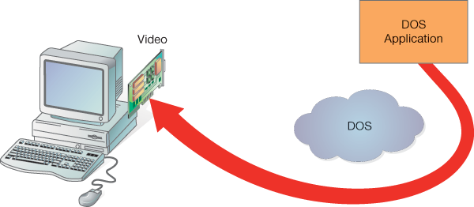
An application “reaching around” DOS to access hardware directly

Slide 9
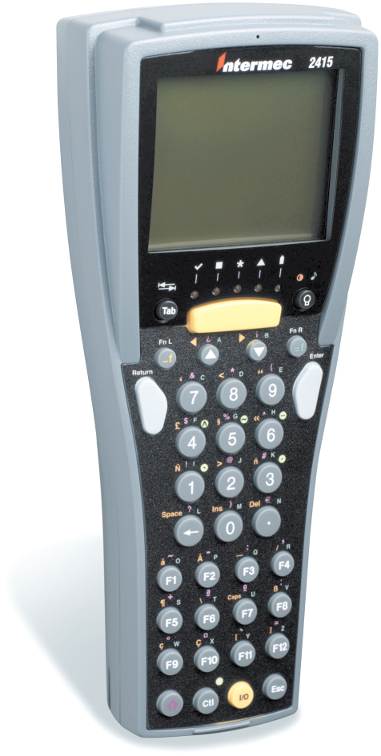
Figure 4-1 A handheld inventory scanner

Slide 10
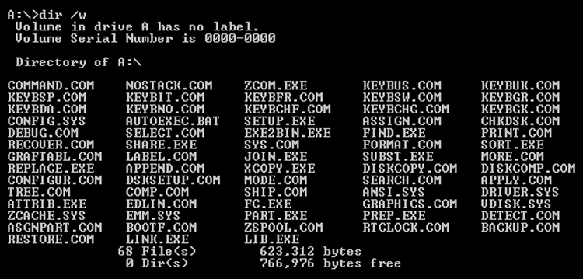
A directory listing of a DOS boot drive with 68 files—many handy utilities and programs—that take up less than half the available space!

Slide 11
DOS Basics
DOS Weaknesses
  User Interface Limits
  Processor Mode Limits
  Memory Limits
  Multitasking Limits
  Hard drive limits
Notes:
Point out to the students that the limits discussed here are specific to MS-DOS, and may not apply to newer versions of DOS from IBM and others.

Slide 12
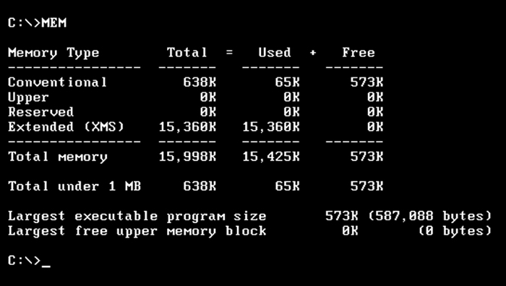
Figure 4-2 The MEM command shows DOS memory usage

Slide 13
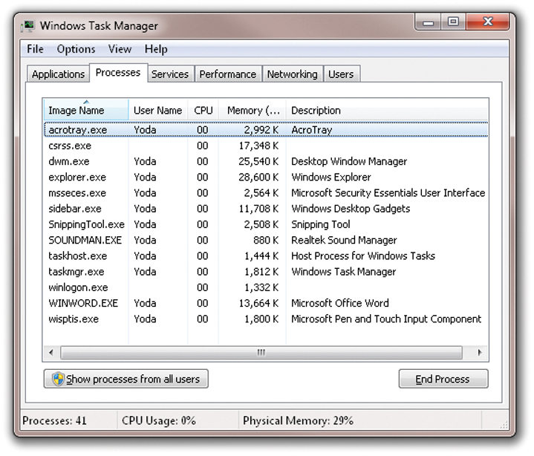
Figure 4-3 What a different 20 years makes! The Task Manager in Windows 7 shows the memory in use by processes (active portions of running programs)

Slide 14
Installing DOS
DOS Hardware Requirements
  An Intel/Microsoft standard PC
  6 MB of free hard disk space for the DOS
  utilities, if installing onto a hard disk
  512 KB of memory

Slide 15
Installing DOS
Preparing for DOS Installation
  Clean install wipes out existing OS
  Setup program prepares hard disk
    Creates a partition
    Formats the partition
  Logical Drive

Slide 16
Installing DOS
Logical Drive
  An area in a partition viewed as a drive
  DOS assigns a drive letter
  It is a logical drive
  DOS requires FAT format
    FAT16 for MS-DOS
    FAT32 for FreeDOS

Slide 17
Installing DOS
Partitioning a Hard Disk in DOS
  Factory-ready physical hard disk
    Concentric tracks
    Each track divided into sectors—the
    physical format
    Each sector holds 512 bytes
    Master boot record (MBR) is first sector
      Created by disk partitioning program
      Contains 64-byte partition table
Notes:
Although the DOS Setup program will partition a hard disk during the installation process, students should understand a few concepts about preparing a disk. This section on partitioning is intended to present this information. Point out that they will be making choices in the Setup program that will control how the disk is partitioned. Indeed, installation programs for other OSs (for example, Linux and Windows) also present the user with similar choices. For more detailed information on partitioning check out the article titled MS-DOS Partitioning Summary at the Microsoft site (http://support.microsoft.com/kb/69912/EN-US/).
Keep in mind that the partition size limits pertain only to MS-DOS through version 6.22. The rules changed for FDISK for Windows 9x in order to provide larger partitions for the FAT32 file system, and therefore, FreeDOS and other versions of DOS that support FAT32 support large partitions.

Slide 18
Installing DOS
Partitioning Programs
  OS Setup programs include disk
  partitioning
  Separate disk partitioning programs
  come with OSs
  FreeDOS
    FDISK
    XFDISK – an extended FDISK

Slide 19
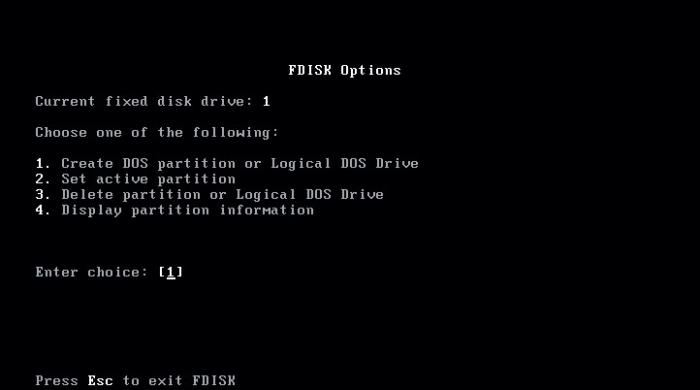
Figure 4-4 The FISK Options menu displays the main operations you can perform

Slide 20
Installing DOS
Partitioning with FDISK
  MS-DOS maximum disk size = 4 GB
  MS-DOS maximum primary partition
  size = 2 GB
  Primary partition has only one logical drive
  Extended partition contains one or more
  logical drives
  After partitioning, then format logical
  drives

Slide 21
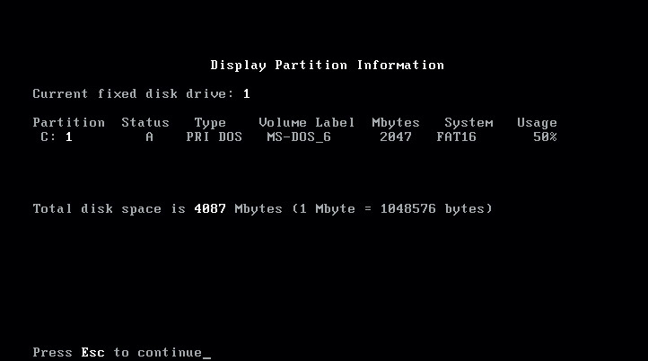
Figure 4-5 The FDISK Display Partition Information displays the partitioning information for a hard disk

Slide 22
Installing DOS
Partitioning with FDISK
  FDISK is menu-driven
  Boot from disk with DOS startup files
  and utilities
  Run FDISK to create a partition
  Run FORMAT to format partition
    format c: /s

Slide 23
Installing DOS
FreeDOS
  Downloading FreeDOS
    Point browser to www.freedos.org
    Access download page
    Select a distribution
      FDBASECD.ISO: 8 MB
        Install on PC or into a VM
        Basic utilities
      FDFULLCD.ISO: 153 MB
        Install or PC or into a VM or create a live CD
        More utilities

Slide 24
Installing DOS
FreeDOS
  Creating a Virtual Machine for FreeDOS
    Create a VM with the smallest amount of
    RAM your hypervisor will allow.
    Use to
      Install FreeDOS
      Boot into a live CD
Notes:
Ask the students if they can think of an advantage to creating a VM if you are only going to use it to boot into a FreeDOS live CD. They should come to the conclusion that the advantage of this is that they could then run it in a window and be free to work in other applications on their computer, perhaps taking notes or browsing the Web.

Slide 25
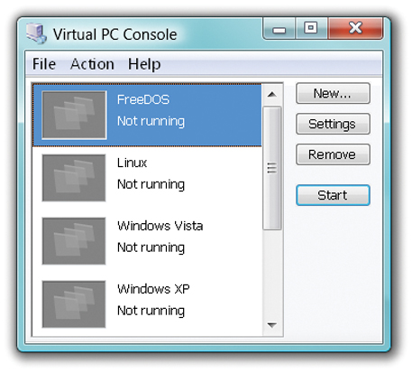
Figure 4-6 The Virtual PC Console with FreeDOS

Slide 26
Installing DOS
FreeDOS
  Running FreeDOS from a live CD
    Recommended: Create a VM
    Boot from a live CD (in the VM or not)
    Follow instructions to run from live CD
    Most DOS commands are available

Slide 27
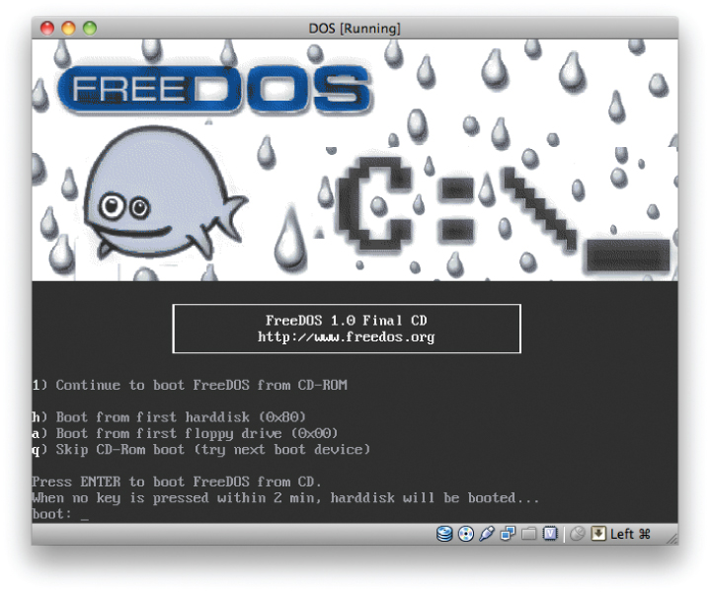
Figure 4-7 The initial FreeDOS menu from the Installation/Live CD disc, shown in a VirtualBOX VM running in MAC OS X

Slide 28
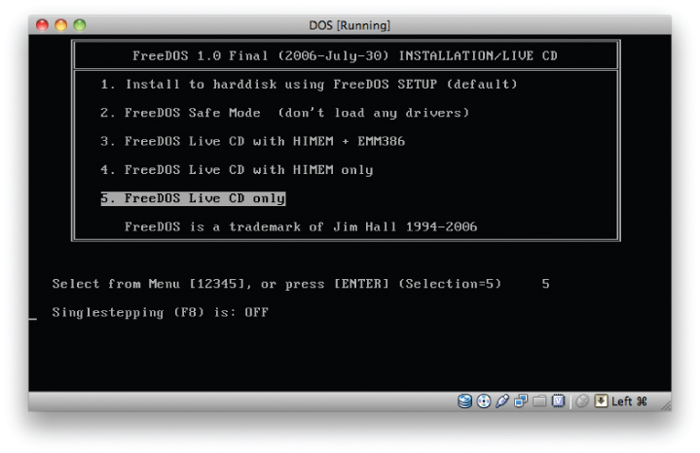
Figure 4-8 The second menu from the Installation/Live CD disc. Select one of the live CD options

Slide 29
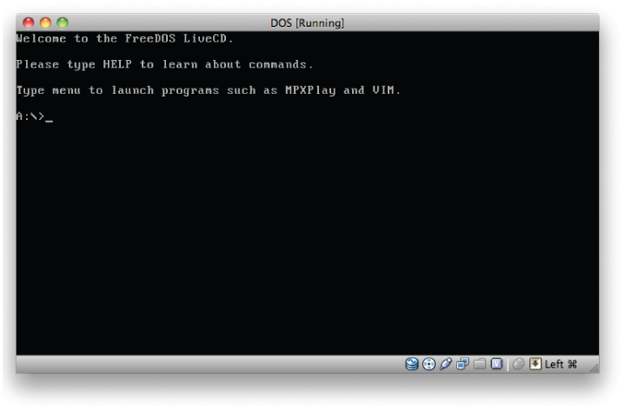
Figure 4-9 The FreeDOS Live CD DOS prompt

Slide 30
Installing DOS
Step-by-Step 4.01
Installing FreeDOS
Page 116

Slide 31
Installing DOS
After FreeDOS install
  During reboot
    FDCONFIG.SYS commands run
    AUTOEXEC.BAT commands run
  After
    Last line displayed is DOS prompt
    Current drive + current directory +
    greater-than sign (>)

Slide 32
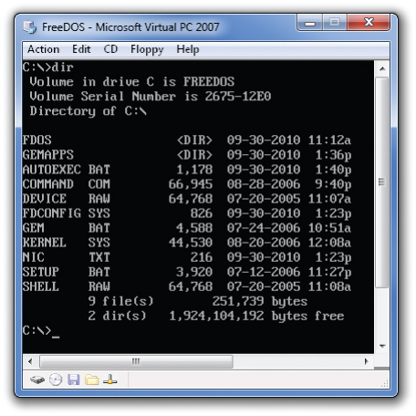

Slide 33
Working with the DOS Command Prompt
Success at the DOS Prompt
  How Does DOS Interpret a Command?
    The command interpreter (COMMAND.COM
    in both MS-DOS and FreeDOS)
      Receives the command
      Finds the program code for the command
      Loads the program code into memory
      Passes any additional instructions to the command.

Slide 34
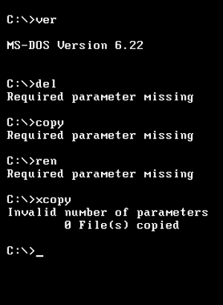
Figure 4-10 Parameter error messages

Slide 35
Working with the DOS Command Prompt
Success at the DOS Prompt (cont.)
  How is a Program Found and Loaded?
    DOS checks its own internal commands
    If command not found then …
    DOS looks for external command
      In current directory
      In search path
      Searches for a match with .COM, .EXE, and
      then .BAT

Slide 36
Working with the DOS Command Prompt
Success at the DOS Prompt (cont.)
  Which Command Will Accomplish the Task?
    Use Help
      DOS program that lists DOS commands
      Describes functions

Slide 37
Installing DOS
Step-by-Step 4.02
Using the Online Help in DOS
Page 123

Slide 38
Working with the DOS Command Prompt
Success at the DOS Prompt (cont.)
  What is the Correct Syntax?
    Syntax is a set of rules for correctly entering
    a command
    Includes command name and parameters
    See syntax:
      Type command_name followed by /?

Slide 39
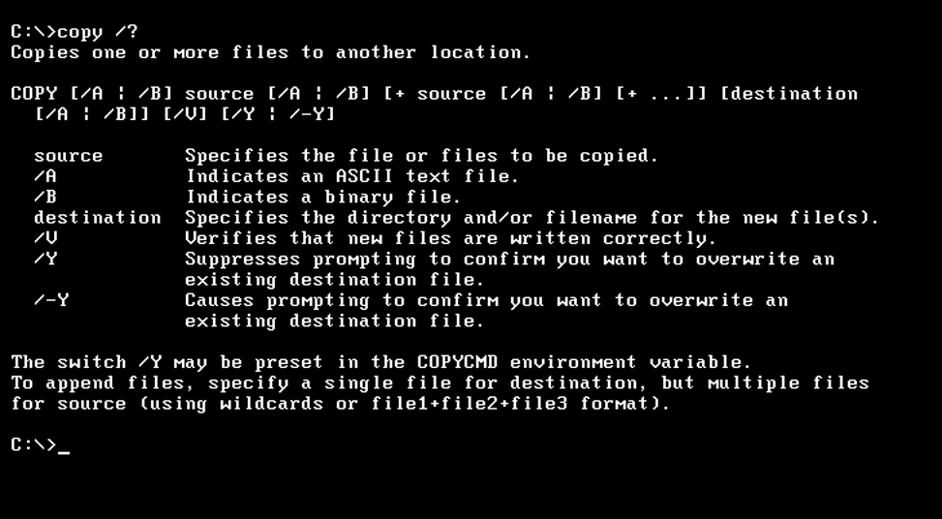
Figure 4-11 The COPY command syntax

Slide 40
Working with the DOS Command Prompt
Operators
  Symbols that affect the behavior of
  commands
    Vertical bar (|) between two commands
      Uses output from first as input for second
      Example: type autoexec.bat | more
      One screenful will display
      Press any key to advance
Notes:
Point out that in the example, “type” is a command to be entered at the command prompt.

Slide 41
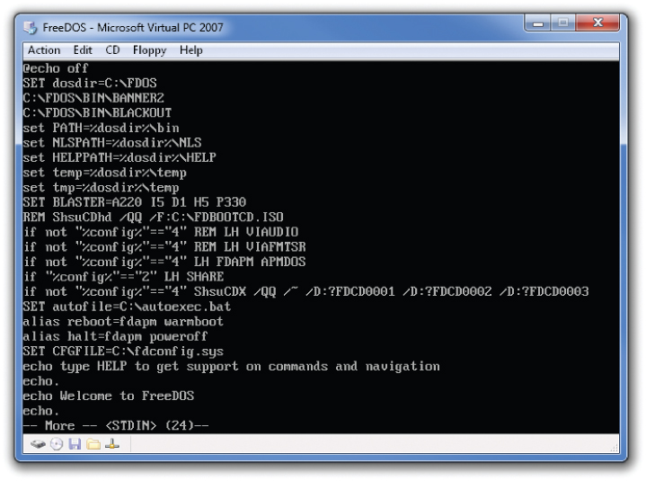
Figure 4-12 The result of sending the output of the TYPE command, operating on the AUTOEXEC.BAT file, to the MORE filter

Slide 42
Working with the DOS Command Prompt
Operators (cont.)
  Symbols that affect the behavior of
  commands (cont.)
    Greater than symbol (>)
      Uses output from command and creates a file
      Example: type autoexec.bat > more
Notes:
Point out that in the example, “type” is a command to be entered at the command prompt.
Remind students that there are many tricks to using DOS, but these few may be the handiest.

Slide 43
Working with the DOS Command Prompt
Learning to Manage Files and Directories
  Symbols that affect the behavior of
  commands
    No-frills file management
    Based on abilities and limits of the FAT file system

Slide 44
Working with the DOS Command Prompt
Learning to Manage Files and Directories
  DOS File Basics
    DOS File-naming Rules
      The 8.3 (eight-dot-three) naming convention
        Up to eight characters in filename
        Followed by a period
        Followed by up to three characters in
        the extension

Slide 45
Working with the DOS Command Prompt
Learning to Manage Files and Directories
  DOS File Basics (cont.)
    More DOS File-naming Rules
      Only contain alphanumeric characters and a few special characters
        $ & # @ ! % ‘ ^ ( ) - _
      Spaces and the following characters are illegal:
        / \ [ ] | < > + = ; , * ?
      Dos is case insensitive
        README.TXT is the same as readme.txt

Slide 46
Working with the DOS Command Prompt
Learning to Manage Files and Directories
  DOS File Basics (cont.)
    The path to a file
      Example: C:\docs\test\ch01.doc
    Wildcards
      * replaces all characters from a point to the
      end of a filename or extension.
      ? Replaces a single character

Slide 47
Working with the DOS Command Prompt
Learning to Manage Files and Directories
  DOS File Basics (cont.)
    DOS File Types
      BAK: a file containing backup data
      BAS: a BASIC program file
      BAT: a batch file
      COM: an executable binary file (a program)
      EXE: an executable binary file using a more
      complicated structure than a COM file (a program)
      SYS: a device driver or operating system file
      TXT: a file containing text without special codes
      for formatting text

Slide 48
Working with the DOS Command Prompt
Learning to Manage Files and Directories
  DOS File Basics (cont.)
    DOS File Types (cont.)
      DOS Executables
        COM, EXE, and BAT
        COM and EXE files contain
        programming code
        BAT files are batch files
Notes:
Please note that the explanation of batch files has been over-simplified for the expected audience. For more advanced students, consider explaining that there are commands that are especially designed to run in batch files. Further, you may explain that simple DOS batch files are the forerunners of the present day shell scripting and more advanced scripting languages.

Slide 49
Working with the DOS Command Prompt
Learning to Manage Files and Directories
  DOS File Basics (cont.)
    DOS File Types (cont.)
      DOS File Attributes
        Read-only
        Archive
        System
        Hidden
        Volume label
        Directory

Slide 50
Working with the DOS Command Prompt
Learning to Manage Files and Directories
  DOS File Basics (cont.)
    DOS File Types (cont.)
      More About DOS File Attributes
        Attributes are used in the FAT file
        system in all OSs
        NTFS and others use these plus
        additional attributes
        ATTRIB command displays and
        modifies attributes

Slide 51
Working with the DOS Command Prompt
Learning to Manage Files and Directories
  DOS File Basics (cont.)
    Root Directory and Other Directories
      A special file that can contain listings of files
      and directories
      Root directory is top-level directory
        Created by FORMAT command
        Contains all other directories and files
      Parent directory contains other directories
      Subdirectory is within a parent

Slide 52
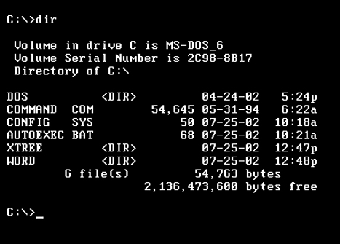
Figure 4-13 MS-DOS directory listing using the DIR command. Notice the Word and Xtree directories.

Slide 53
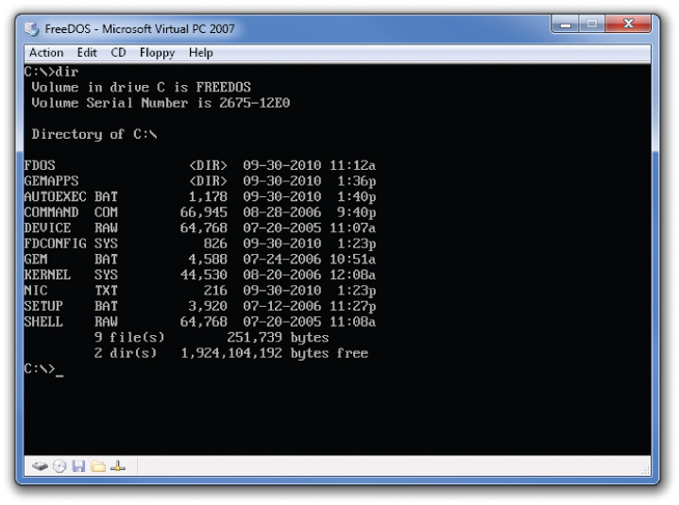
Figure 4-14 A directory listing of the root directory in FreeDOS

Slide 54
Working with the DOS Command Prompt
Learning to Manage Files and Directories
  DOS File Basics (cont.)
    Each directory entry contains this data
      File name
      Extension
      Date and time of creation/modification
      Size
      Attributes
      Beginning cluster number

Slide 55
Working with the DOS Command Prompt
Learning to Manage Files and Directories
  Designing a Directory Structure for File Management
    Like a filing cabinet
      Each logical drive is a drawer
      Each directory in root is a large hanging folder
        Each subdirectory at next level is smaller folder
    Never save data files in root directory
    Store programs in one directory hierarchy
    Store data files in another directory structure

Slide 56
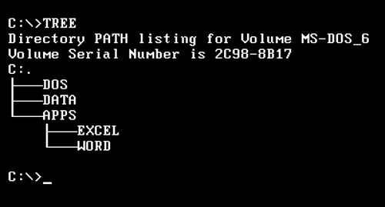
Figure 4-15 Directories viewed with the TREE command

Slide 57
Working with the DOS Command Prompt
Learning to Manage Files and Directories
  Designing a Directory Structure for File Management (cont.)
    Creating and Navigating Directories
    MD (Make Directory)
      Creates a new directory
      Syntax: MD [drive:]path
      Example: md data or md c:\data

Slide 58
Working with the DOS Command Prompt
Learning to Manage Files and Directories
  Designing a Directory Structure for File Management (cont.)
    CD (Change Directory)
      Move between directories
      Syntax: CD path
      Example: cd \data or cd c:\data

Slide 59
Working with the DOS Command Prompt
Learning to Manage Files and Directories
  Use File Management Commands
    TYPE — displays the contents of a file
    on the display screen
    DIR — lists the contents of a directory
    CD — changes the directory
    CLS — clears the display
    COPY — copies a file
    REN — renames a file or directory
    MD — makes a directory

Slide 60
Working with the DOS Command Prompt
Learning to Manage Files and Directories
  Use File Management Commands
    RD — removes an already empty directory
    XCOPY — copies entire directories, as well
    as files
    DISKCOPY— makes a floppy-disk-to-floppy-
    disk copy
    DELTREE — deletes an entire directory and
    its contents
    HELP — displays a listing of DOS commands
    and provides their syntax

Slide 61
Working with the DOS Command Prompt
Step-by-Step 4.03
Managing Files and Directories
Page 131
Notes:
This exercise provides a terrific opportunity to discuss some of the potential situations where knowledge of DOS would be necessary. Ask students to come up with situations where the commands and techniques they use in this exercise would be helpful. If necessary, prompt them by asking them to imagine a situation where Windows will not start successfully and they have need of important files stored on the computer. With experience gained here, they could use Safe Mode with Command Prompt and copy those files off.

Slide 62
The DOS Boot-Up Process
Why You Should Learn the DOS
Boot-Up Process
  Many problems occur during bootup
  Careful observation can reveal where
  problem occurs
  Points the way to the solution

Slide 63
The DOS Boot-Up Process
DOS System Files
  You must be in root of the boot disk
  for startup!
  MS-DOS
    IO.SYS – Handles hardware interaction and
    the loading of device drivers during bootup
    MSDOS.SYS – main (or kernel) component
    of the OS
    COMMAND.COM – command interpreter

Slide 64
The DOS Boot-Up Process
DOS System Files (cont.)
  FreeDOS
    KERNEL.SYS — replaces IO.SYS
    and MSDOS.SYS
    MSDOS.SYS — main (or kernel)
    component of the OS
    COMMAND.COM — command interpreter

Slide 65
The DOS Boot-Up Process
DOS System Files (cont.)
  DOS Configuration Files
    MS-DOS
      CONFIG.SYS
      AUTOEXEC.BAT
    FreeDOS
      FDCONFIG.SYS
      AUTOEXEC.BAT

Slide 66
The DOS Boot-Up Process
DOS System Files (cont.)
  CONFIG.SYS or FDCONFIG.SYS
    Add device drivers
    Modify DOS settings
    Special commands
      BUFFERS
      DEVICE
      DEVICEHIGH
      DOS
      FILES
      STACKS

Slide 67
The DOS Boot-Up Process
DOS System Files (cont.)
  Simple CONFIG.SYS
      files=10
      buffers=10
      dos=high,umb
      stacks=9,256

Slide 68
The DOS Boot-Up Process
DOS System Files (cont.)
  Slightly more complex CONFIG.SYS
      device-himem.sys /testmem:off
      device=oakcdrom.sys /D:mscd001
      files=10
      buffers=10
      dos=high,umb
      stacks=9,256
      devicehigh=ramdrive.sys /E 2048
      lastdrive=z
Notes:
Even this second example is pretty simple. Point out that CONFIG.SYS files can be much more complex than the example above. Depending on the interest level of the students, consider showing them the complex CONFIG.SYS example in the Instructor’s Manual, which is really beyond the scope of the text. It was also to long to put on a slide.

Slide 69
The DOS Boot-Up Process
DOS System Files (cont.)
  AUTOEXEC.BAT
    DOS reads after loading COMMAND.COM
    Most commands place setting in environment
    Common AUTOEXEC.BAT commands
      PATH
      PROMPT
      SET

Slide 70
The DOS Boot-Up Process
DOS System Files (cont.)
  A simple AUTOEXEC.BAT
    path=C:\DOS;
    prompt=$p$g
Notes:
Explain that

Slide 71
The DOS Boot-Up Process
DOS System Files (cont.)
  A slightly more complex AUTOEXE.BAT
    @ECHO OFF
    set dosdir=C:\FDOS
    C:\FDOS\BIN\BANNER2
    C:\FDOS\BIN\BLACKOUT
    set path=%dosdir%\bin
    set NLSPATH=%dosdir%\NLS
    set HELPPATH=%dosdir%\HELP
    set temp=$dosdir%\temp
    set tmp=$dosdir%\temp
    @ECHO ON
Notes:
The above example is only selected lines from a FreeDOS installation.
Depending on the interest level of the students, explain that once a variable is placed in the environment programs batch files can use those values. The above AUTOEXEC.BAT calls the dosdir value by surrounding the variable name with percentage signs. Thus, whenever %dosdir% appears in the batch file, C:\FDOS is substituted.
The instructor manual shows a more advanced AUTOEXEC.BAT.

Slide 72
The DOS Boot-Up Process
DOS System Files (cont.)
  DOS Configuration Files
    View and edit with a text editor
    Windows also uses environment variables
    View environment with SET command

Slide 73
The DOS Boot-Up Process
Examining the Bootup Process
  PC powers up BIOS, “learns” about hardware
  Hardware settings stored in CMOS RAM
  OS learns from configuration files
  Cold boot (power switch)
  Warm boot (CTRL+ALT+DELETE or reset button)
  POST
  Bootstrap loader
Notes:
This discussion of the bootup process begins in the third paragraph on page 137.

Slide 74
The DOS Boot-Up Process
Examining the Bootup Process (cont.)
  Bootstrap loader
    Looking for OS loader program
    Reads MBR on hard drive looking for
    a primary partition
    Boot sector holds OS loader program
Notes:
This discussion of the bootup process begins in the third paragraph on page 137.

Slide 75
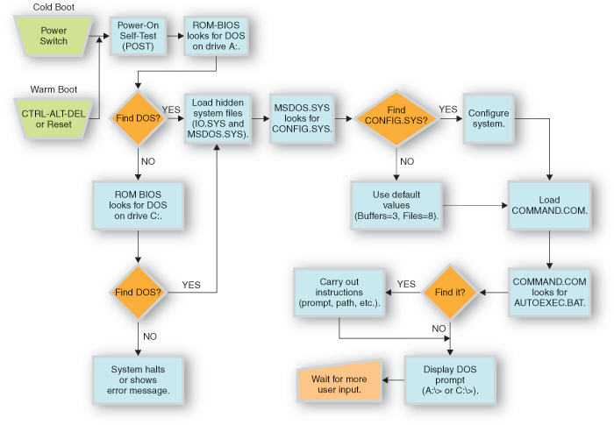
Flowchart of the MS-DOS boot-up process

Slide 76
Troubleshooting Common DOS Problems
“Non-System Disk” Error Message
  OS Loader program cannot find IO.SYS
  and or MSDOS.SYS (or KERNEL.SYS
  in FreeDOS)
  Most likely cause is data floppy disk
  in drive
  Solution: check for and remove disk;
  reboot

Slide 77
Troubleshooting Common DOS Problems
“Bad or Missing Command Interpreter”
  COMMAND.COM missing or wrong
  version
  Boot from disk with correct version
  Copy COMMAN.COM file

Slide 78
Troubleshooting Common DOS Problems
“Bad Command or File Name” or
“File Not Found”
  Check and recheck spelling
  Reenter the command

Slide 79
Troubleshooting Common DOS Problems
Request to Enter the Current Date and Time
  On older systems if AUTOEXEC.BAT
  missing
  What drive did PC start from?
  If removable disk present,
  remove and reboot

Slide 80
Chapter 4 Summary
LO 4.1 DOS Basics
  First there was PC DOS, which Microsoft licensed to IBM for personal computer (PC) products, beginning with the IBM PC in 1981. Later Microsoft licensed DOS as MS-DOS to many other PC manufacturers, often customized and then sold under that company’s name as an original equipment manufacturer (OEM) product.

Slide 81
Chapter 4 Summary
LO 4.1 DOS Basics (cont.)
  The major commercial versions of DOS are no longer available, but there are free versions of DOS; we used FreeDOS for the examples and exercises in this chapter.
  One reason DOS is still in limited use today is its small size, which makes it a good choice for embedded systems.

Slide 82
Chapter 4 Summary
LO 4.1 DOS Basics (cont.)
  The DOS user interface is not easy to
  work with
  DOS can access only the real-mode
  capabilities of the Intel processors
  DOS is a single-tasking OS
  DOS provides limited services for
  DOS applications
  DOS application can only use conventional memory

Slide 83
Chapter 4 Summary
LO 4.2 Installing DOS
  The DOS Setup program will partition and format a hard drive, if needed.
  The hardware requirements for any version of DOS are minimal: an IBM or compatible personal computer, 6 MB of free hard disk space for the DOS utilities if you are installing onto a hard disk, and 512 KB of memory.

Slide 84
Chapter 4 Summary
LO 4.3 Working with the DOS Command Prompt
  COMMAND.COM interprets commands by parsing what you enter at the command line. The first parameter is assumed to be the command itself, and COMMAND.COM looks for this command in memory and on disk, loading it into memory and passing the parameters to it.

Slide 85
Chapter 4 Summary
LO 4.3 Working with the DOS Command Prompt (cont.)
  Internal commands are commands that are part of COMMAND.COM and are always available to use when you are at a DOS command prompt. They are very fast to access.
  User the DOS Help program to determine the command to use and the correct syntax for that command.

Slide 86
Chapter 4 Summary
LO 4.3 Working with the DOS Command Prompt (cont.)
  DOS and the FAT file system use a naming convention for files and directories called
  8.3 (eight-dot-three). It is best to use only
  alpha-numeric characters for 8.3 file names,
  even though some non-alphanumeric
  characters work.

Slide 87
Chapter 4 Summary
LO 4.3 Working with the DOS Command Prompt (cont.)
A file’s extension can indicate the type
of file.
File attributes determine how DOS
handles a file or directory. The file
attributes are read-only, archive, system, hidden, volume label, and directory.

Slide 88
Chapter 4 Summary
LO 4.3 Working with the DOS Command Prompt (cont.)
DOS considers three types of files to
be executable: COM, EXE, and BAT.
COM and EXE files both contain program-ming code, while BAT files are batch files, which are not programs, but text files that contain commands that are interpreted line
by line.

Slide 89
Chapter 4 Summary
LO 4.3 Working with the DOS Command Prompt (cont.)
A directory is a special file that can
contain listings of files and other
directories. The root directory is the
top-level directory and the only one
that the FORMAT command creates.

Slide 90
Chapter 4 Summary
LO 4.4 The DOS Boot-up Process
  It is important to understand the boot-up
  process of an OS in order to troubleshoot
  failures that occur during the process.
  A cold boot of a personal computer occurs
  when you turn on the power switch. A warm
  boot of a personal computer occurs when you press ctrl-alt-delete. A computer Reset button resets a running computers without a power-
  down and power-up cycle.

Slide 91
Chapter 4 Summary
LO 4.4 The DOS Boot-up Process (cont.)
  The order of events during boot up of DOS is cold or warm boot, then POST, and then the bootstrap loader looks on the A: or C: drive (or any other drive listed in the BIOS setup) and loads the boot record. Then IO.SYS and MSDOS.SYS (or just KERNEL.SYS in FreeDOS) are loaded, CONFIG.SYS (if it exists is read and used by MSDOS.SYS (KERNEL.SYS), COMMAND.COM is loaded, AUTOEXEC.BAT
  (if it exists) is read and used by COMMAND.COM, and finally, the DOS prompt displays.

Slide 92
Chapter 4 Summary
LO 4.5 Troubleshooting Common DOS Problems
  A failed start-up to DOS that results in the
  “Non-System Disk” error message means
  the OS loader program cannot find IO.SYS
  and/or MSDOS .SYS (or KERNEL.SYS in FreeDOS). The most likely cause of the
  problem is that a data floppy disk was left
  in drive A:. Check for, and remove, any floppy disks in the drive and reboot the computer.

Slide 93
Chapter 4 Summary
LO 4.5 Troubleshooting Common DOS Problems (cont.)
  A failed start-up to DOS that results in a
  “Bad or Missing Command Interpreter” error message means the file COMMAND.COM is missing or is a different version than IO.SYS and MSDOS.SYS. Boot from a bootable floppy disk or bootable disc of the correct version, and copy the COMMAND.COM file to the root of C:.

Slide 94
Chapter 4 Summary
LO 4.5 Troubleshooting Common DOS Problems (cont.)
  When you enter a command and see the
  “Bad Command or File Name” or “File Not Found” error message, check and recheck
  your spelling and reenter the command.

Slide 95
Chapter 4 Summary
LO 4.5 Troubleshooting Common DOS Problems (cont.)
  If you are required to enter the date and time
  when you boot up a computer, this most likely means that there is no AUTOEXEC.BAT on the root of the boot disk. Create an AUTOEXEC.BAT file, even if it is empty, and just about any computer built since 1984 will simply use
  the internal clock to get this information.

